Slide 1
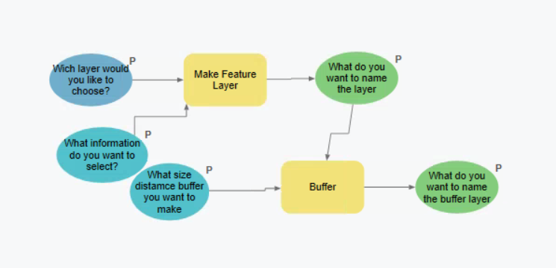
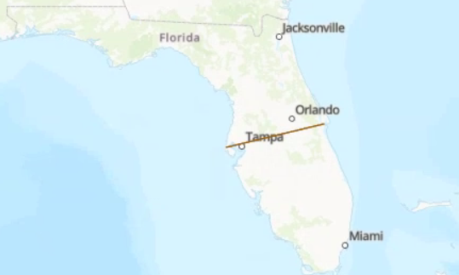
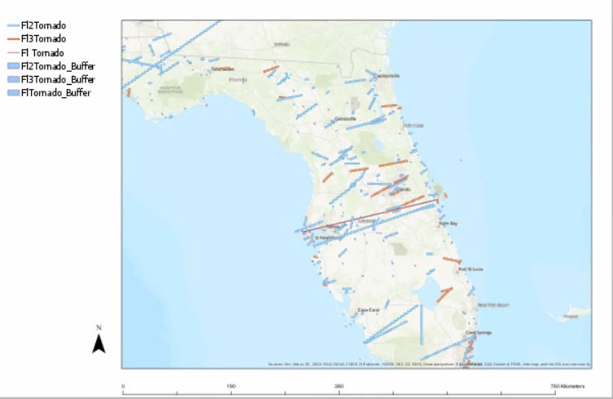
Exploring the Impact of a Rare Event: Tornado in Tampa Florida
Introduction
Conclusions
This project we are Exploring the Impact of Tornados from Florida.
The NOAA SVRGIS database is useful not only for larger regional analyses, but also for specific studies of single tornado events.
By combining tornado tract information, buffer analysis, and clip processes, it is possible to identify specific locations and the potential impact of severe weather events.
Future work might explore automating the steps displayed in this exercise to simplify severe weather impact analysis.
Figure 1 (above): Visual Diagram of Model and Processes
Figure 2 (below): Location of Florida, Tampa where the Tornado was traced, and Example of Properties Affected
Data
Data on tornado tracts were obtained from the NOAA Storm Prediction Center, SVRGIS page. Attributes included: date, time, length, width, and start and end locations.
Data on parcel boundaries were obtained from the NJ Office of GIS, “Parcels and MOD-IV Composite of New Jersey.”
Bibliography
ESRI. 2019. ArcGIS Pro: Model Builder. Redlands, CA.
NJOIS. 2019. Parcels and MOD-IV Composite of Florida. Downloaded 28 October 2019.
NOAA. 2019. NOAA Storm Prediction Center: Severe Weather GIS Data Page. Downloaded: 28 October 2019.
Methods
To explore the impact of this particular tornado, I completed the following steps:
Created a Model in ArcGIS Pro to document the processes and steps (see Figure 1).
Selected the specific Florida tornado event from the over 63 thousand tornados in the NOAA SVRGIS database (1950-2019).
Created a buffer of 25 yards, characterizing the 50 yard width of the tornado.
Clipped parcel boundaries to determine how many properties may have been affected by the tornado.
Henrique Tamayo
17 June 2021

